Slide 1
Problem Solving By Searching
Problem Solving Agents
Solutions and Performance
Uninformed Search Strategies
Avoiding Repeated States/Looping
Partial Information
Summary

Slide 2
Problem Solving Agent
Problem-solving agents: find sequence of actions that achieve goals.
Problem-Solving Steps:
Goal Formulation: where a goal is set of acceptable states.
Problem Formulation: choose the operators and state space.
Search
Execute Found Solution

Slide 3
Preliminaries
We need to define two things:
Goal Formulation
Define objectives
Problem Formulation
Define actions and states

Slide 4
Problem Formulation State Space Search
Four components:
State Space and Initial state
Actions (successor function)
Goal test
Path Cost

Slide 5
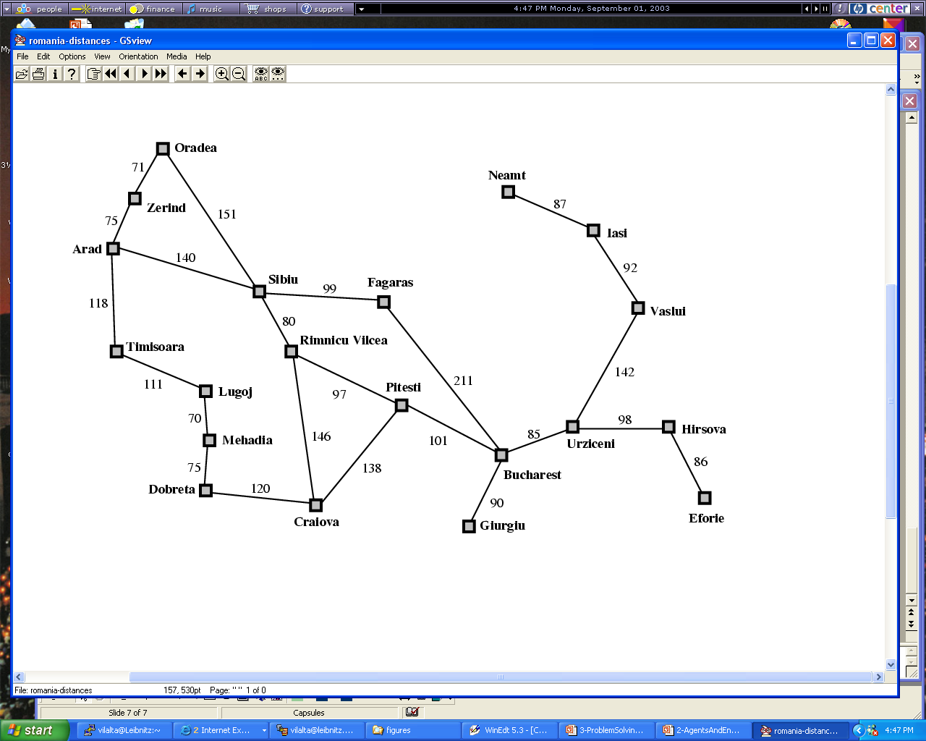
Example

Slide 6
Other Examples
Toy Problems:
Vacuum World
8-puzzle
8-queens problem

Slide 7
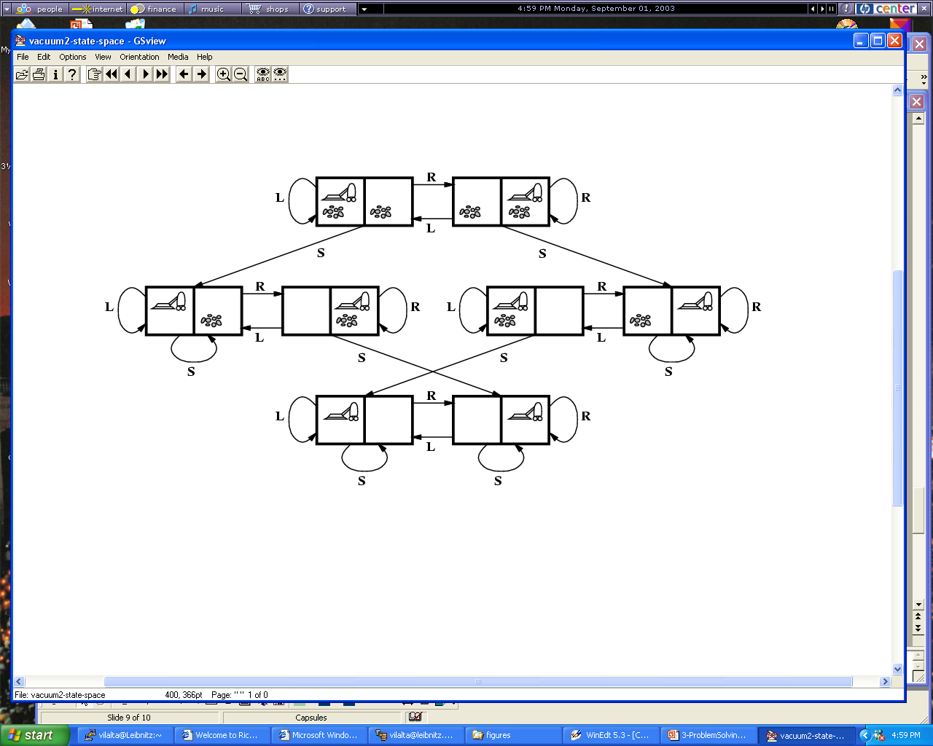
Figure 3.3

Slide 8
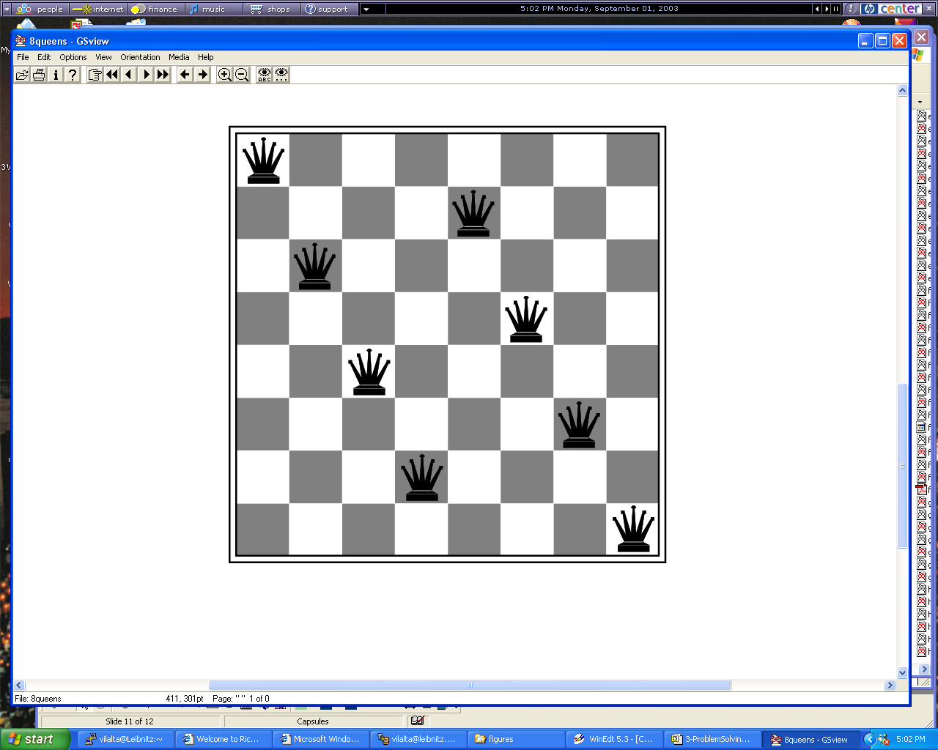
Figure 3.5

Slide 9
Other Examples
Real Problems
Route-Finding Problem
Robot Navigation
Automatic Assembly Sequencing
Protein Design
Internet Searching

Slide 10
Problem Solving By Searching
Introduction
Solutions and Performance
Uninformed Search Strategies
Avoiding Repeated States
Partial Information
Summary

Slide 11
Solutions
We search through a search tree
We expand new nodes to grow the tree
There are different search strategies
Nodes contain the following:
state
parent node
action
frequently path cost
maybe depth

Slide 12
Search Tree
Initial state
Expanded nodes

Slide 13
Performance
Four elements of performance:
Completeness (guaranteed to find solution)
Optimality (optimal solution?)
Time Complexity
Space Complexity

Slide 14
Performance
Complexity requires three elements:
Branching factor b
Depth of the shallowest goal node d
Maximum length of any path m in the state
space

Slide 15
Problem Solving By Searching
Introduction
Solutions and Performance
Uninformed Search Strategies
Avoiding Repeated States
Partial Information
Summary

Slide 16
Breadth-First Search
Root is expanded first
Then all successors at level 2.
Then all successors at level 3, etc.
Properties:
Complete (if b and d are finite)
Optimal (if path cost increases with depth)
Cost is O(b^{d+1})
Storage Let n=b^{d+1}: O(n)

Slide 17
Search

Slide 18
Uniform-Cost Search
Expansion Approach---expands nodes completely
Strategy: Expand node with lowest path cost.
Properties:
Complete (if b and d are finite)
Optimal (if path cost increases with depth)
Cost: Similar to Breadth-first Search
Could be worse than breadth first search

Slide 19
Search

Slide 20
Depth-First Search
Expand the deepest node at the bottom
of the tree.
Properties:
Incomplete
suboptimal
Space complexity is only O(bd)
Backtracking even does
better space-wise: O(d)
Only store the nodes on
the current path including
their unexpanded sibling nodes

Slide 21
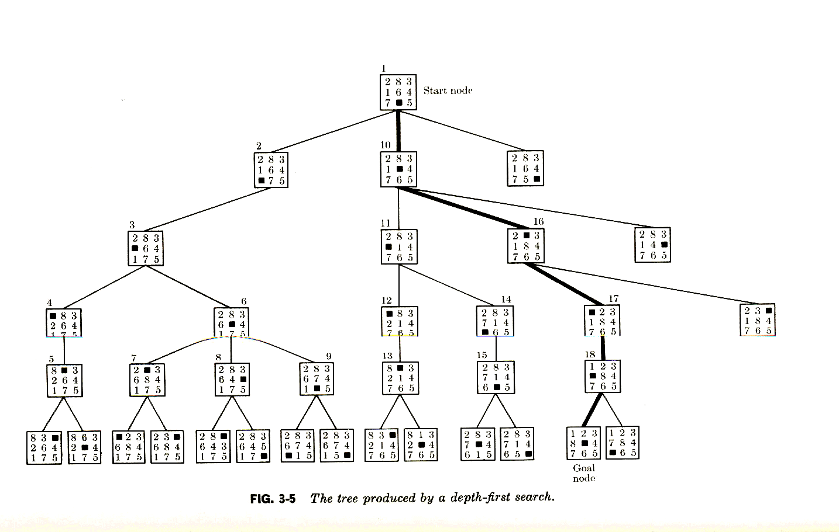
Tree Depth First Search with Depth Bound L
Space Complexity Backtracking: O(d)
Space Complexity Expansion Depth-first Search: O(b*d)

Slide 22
Search

Slide 23
Depth-Limited
Like depth-first search but with
depth limit L.
Properties:
Incomplete (if L < d)
nonoptimal (if L > d)
Time complexity is O(b^{L})
Space complexity is O(bL)

Slide 24
Iterative Deepening
A combination of depth and breadth-first
search.
Gradually increases the limit L
Properties:
Complete (if b and d are finite)
Optimal if path cost increases with depth
Time complexity is O(b^{d})

Slide 25
Problem Solving By Searching
Introduction
Solutions and Performance
Uninformed Search Strategies
Avoiding Repeated States/Looping
Partial Information
Summary

Slide 26
Avoiding Looping & Repeated States (relates to expansion search)
Use a list of expanded states; non-expanded
states (open and close list)
Use domain specific knowledge
Use sophisticated data structures to find
already visited states more quickly.
Checking for repeated states can be quite
expensive and slow down the search alg.
Remark: Non-expansion search strategies have to keep track of what operators have already been applied to avoid looping.

Slide 27
Problem Solving By Searching
Introduction
Solutions and Performance
Uninformed Search Strategies
Avoiding Repeated States
Partial Information
Summary

Slide 28
Partial Information
Knowledge of states or actions is incomplete.
Sensorless problems
Contingency Problems
Exploration Problems

Slide 29
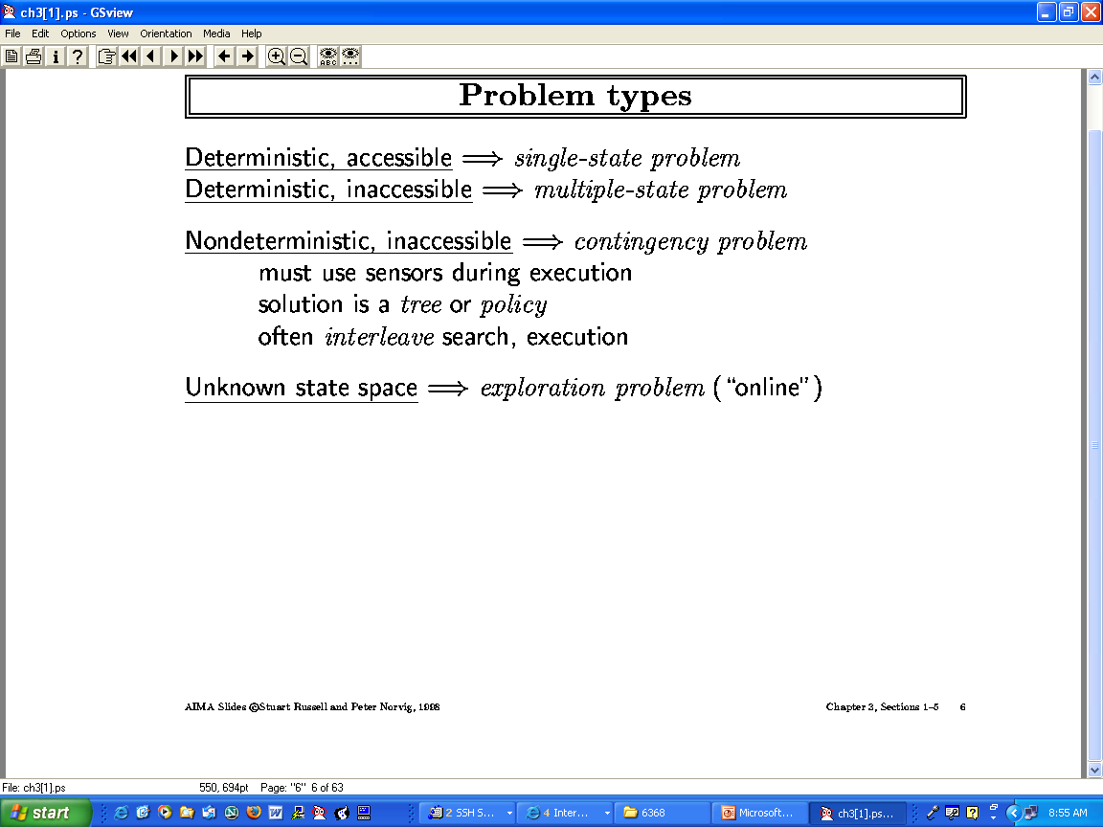

Slide 30
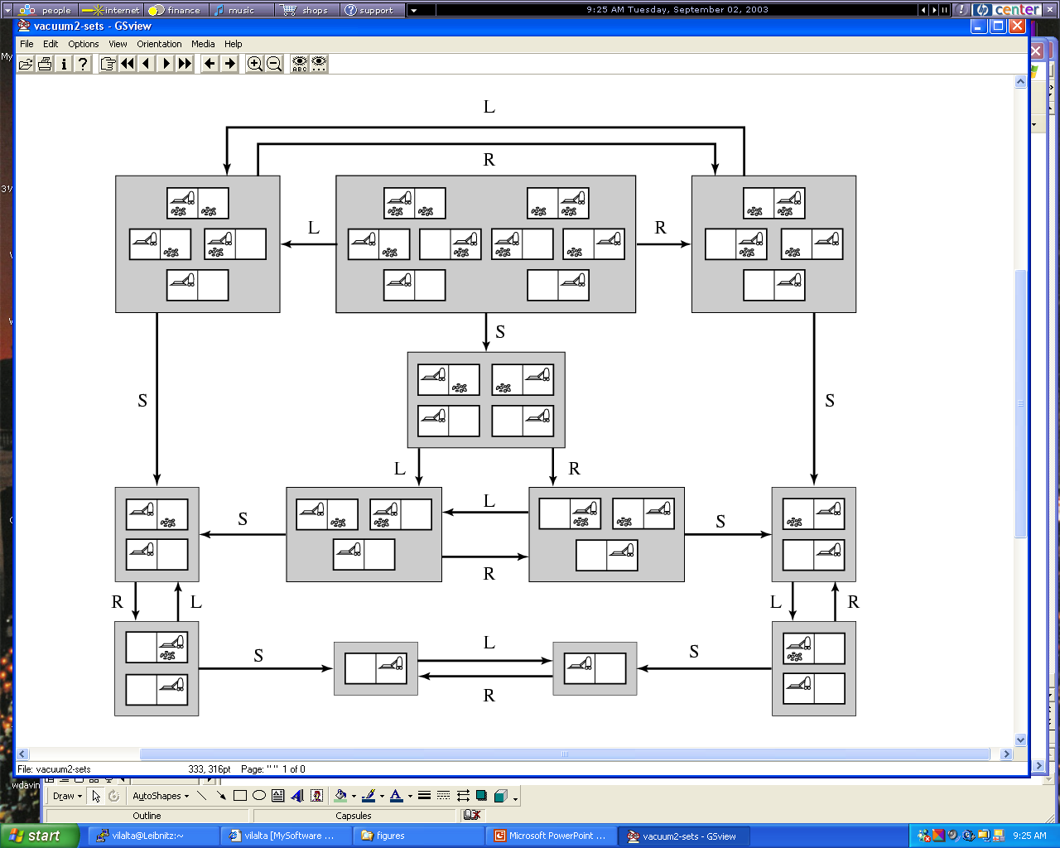
Figure 3.21
Goal State
Goal State

Slide 31
Problem Solving By Searching
Introduction
Solutions and Performance
Uninformed Search Strategies
Avoiding Repeated States
Partial Information
Summary

Slide 32
Summary
To search we need goal and problem
formulation.
A problem has initial state, actions, goal test,
and path function.
Performance measures: completeness,
optimality, time and space complexity.

Slide 33
Summary
Uninformed search has no additional
domain specific knowledge: breadth and depth-first
search, depth-limited, iterative deepening,
bidirectional search.
In partially observable environments, one
must deal with uncertainty and incomplete
knowledge.

